Slide 1
Is pizza a soup, salad, or sandwich?

Slide 2
Communicating Research with Effective Data Visualization
AFS2024 Workshop - Day 1
Megumi Oshima & Pavel Dimens

Slide 4
5 Minute Break

Slide 5

ggplot2::ggplot()
Plotting the “grammar of graphics” way

Slide 6
Tidy data
Month | FishID_001 | FishID_002 | FishID_003 | FishID_004
4 | 3 | 7.5 | 3.2 | 10
5 | 3.6 | 8 | 4 | 10.5
6 | 4.2 | 8.4 | 4.3 | 11
7 | 4.7 | 9.5 | 5.1 | 12
Month | FishID | TL
4 | 001 | 3
4 | 002 | 7.5
4 | 003 | 3.2
4 | 004 | 10
5 | 001 | 3.6
5 | 002 | 8
5 | 003 | 4
5 | 004 | 10.5
Long
Wide
Notes:
The first step of creating a plot with ggplot is to tidy data into the correct format. “Long” vs “wide”
Long data frames have one row for every observation and a column for each variable
This example I have each fish as a separate column and the month that the length observation was taken as the rows
This makes it easier to aggregate and separate your data to make different kinds of plots without having to change the input style

Slide 7
Data properties → Visual properties
FishID | TL | Age
001 | 3 | 5
002 | 3.2 | 7.5
003 | 8.9 | 10
004 | 9.5 | 12
005 | 6 | 8
Notes:
Once you have your data table in the long form, you want to represent the numbers or categories or text in it, in a visual way. This concept is referred to as mapping. Mapping is just corresponding the properties of the data to visual properties in a graphic. For example, we have total length and age, that we are going to map to y and x positions, and then we will map those into points at those positions.

Slide 8
Data properties → Visual properties
FishID | y | x
001 | 3 | 5
002 | 3.2 | 7.5
003 | 8.9 | 10
004 | 9.5 | 12
005 | 6 | 8
Notes:
Once you have your data table in the long form, you want to represent the numbers or categories or text in it, in a visual way. This concept is referred to as mapping. Mapping is just corresponding the properties of the data to visual properties in a graphic. For example, we have total length and age, that we are going to map to y and x positions, and then we will map those into points at those positions.

Slide 9
Data properties → Visual properties
FishID | y | x
001 | 3 | 5
002 | 3.2 | 7.5
003 | 8.9 | 10
004 | 9.5 | 12
005 | 6 | 8
Notes:
Once you have your data table in the long form, you want to represent the numbers or categories or text in it, in a visual way. This concept is referred to as mapping. Mapping is just corresponding the properties of the data to visual properties in a graphic. For example, we have total length and age, that we are going to map to y and x positions, and then we will map those into points at those positions.

Slide 10
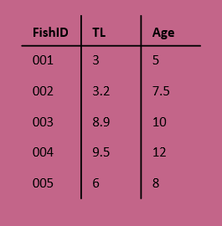
Components of a ggplot
Coordinates
(x, y)
Mapping
Data
Facets
Layers
Theme
Scales

Slide 11
Components of a ggplot
Data
Mapping
Layers
Scales
(x, y)
Facets
Coordinates
Theme
Notes:
Scale controls the mapping of values in the data space to values in the aesthetic space – taking a categorical variable like sex, and turning those into categories 1,2,3,4 and then using those to index what color to use from a vector of colors
Another example: continuous y scale maps larger numbers to vertically higher positions in space

Slide 12
Building a ggplot
Data
Mapping
Layers
(x, y)
Notes:
Data – consists of varaibles
Mapping – corresponding data properties to visual properties
Aesthetics – visual properties of geoms (line color, point shape, positions, etc)
Geoms – geometric objects that represent the data (lines, points, bars, etc)

Slide 13
Building a ggplot
Data
Mapping
Layers
ggplot(
data = blackdrum
)
(x, y)

Slide 14
Building a ggplot
Data
Mapping
Layers
ggplot(
data = blackdrum
)
ggplot(
data = blackdrum,
mapping = aes(
x = tl,
y = otoage
)
)
(x, y)
Notes:
Mapping is the set of instructions on how to make pairs of graphical attributes and parts of the data

Slide 15
Building a ggplot
Data
Mapping
Layers
ggplot(
data = blackdrum
)
ggplot(
data = blackdrum,
mapping = aes(
x = tl,
y = otoage
)
)
geom_line() +
geom_point()
+
(x, y)
Notes:
Layers are what take the mapped data and display it into a graph. Layers have 3 parts, geometry (aka how the data is displayed-line, points, bars, etc), statistical transformations (e.g. adding a trendline), position adjustments (where the data is being shown on the graph)

Slide 16
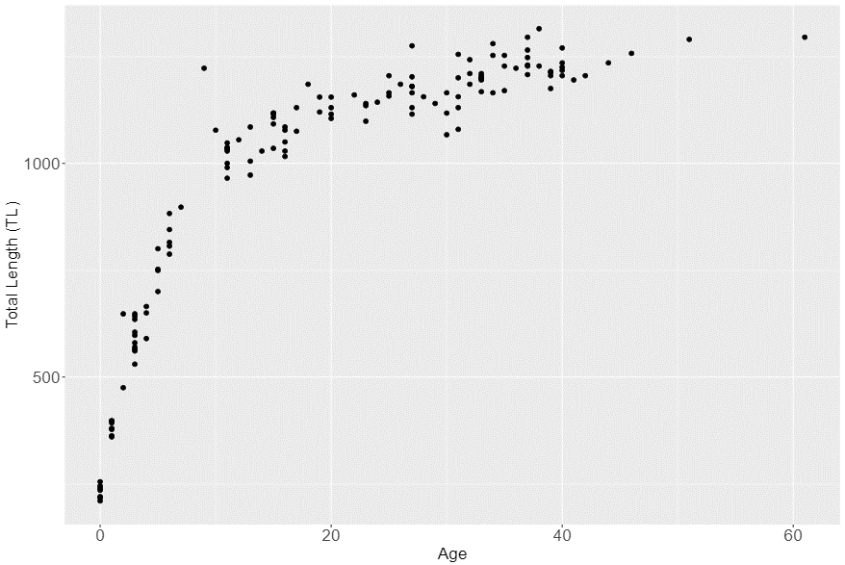
Syntax of a ggplot
ggplot(
data = blackdrum,
mapping = aes(
x = otoage,
y = tl
)
) +
geom_point(
mapping = aes(
color = sex
)
) +
labs(
x = “Total Length (TL)”,
y = “Age”
) +
theme_bw()
(x, y)
Notes:
Layers are what take the mapped data and display it into a graph. Layers have 3 parts, geometry (aka how the data is displayed-line, points, bars, etc), statistical transformations (e.g. adding a trendline), position adjustments (where the data is being shown on the graph)

Slide 17
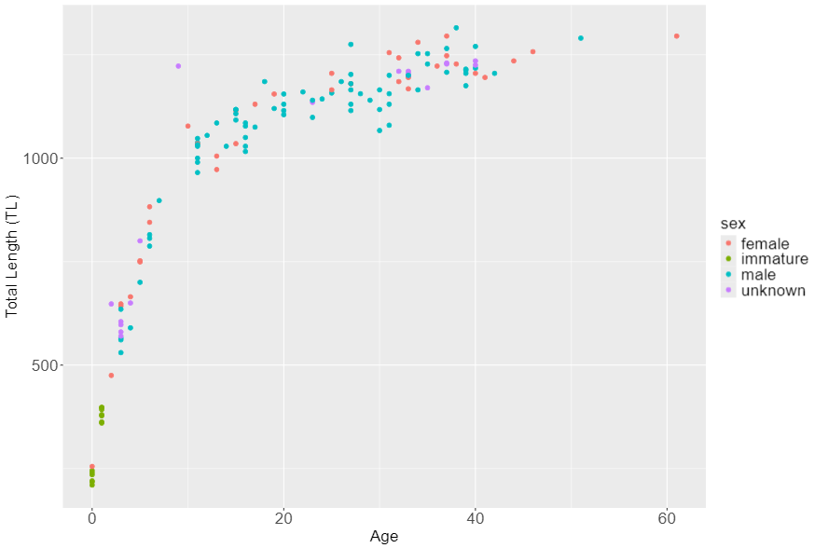
Syntax of a ggplot
ggplot(
data = blackdrum,
mapping = aes(
x = otoage,
y = tl
)
) +
geom_point(
mapping = aes(
color = sex
)
) +
labs(
x = “Total Length (TL)”,
y = “Age”
) +
theme_bw()
(x, y)
Notes:
Layers are what take the mapped data and display it into a graph. Layers have 3 parts, geometry (aka how the data is displayed-line, points, bars, etc), statistical transformations (e.g. adding a trendline), position adjustments (where the data is being shown on the graph)

Slide 18
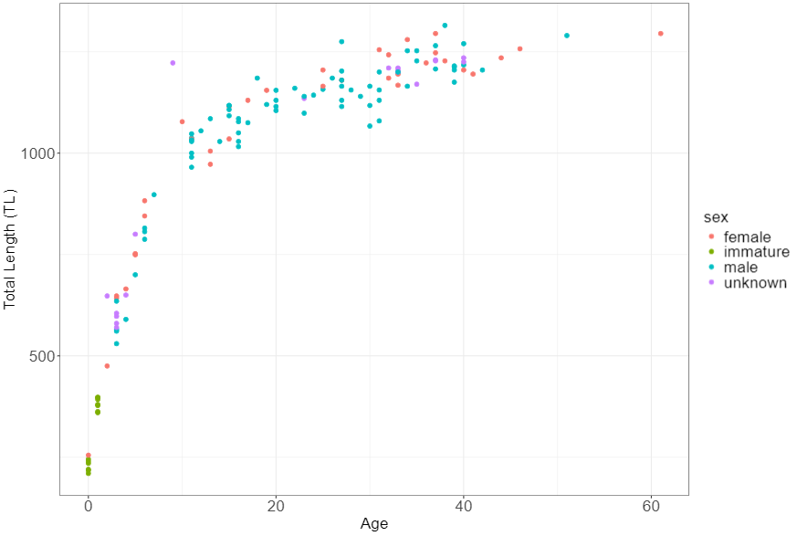
Syntax of a ggplot
ggplot(
data = blackdrum,
mapping = aes(
x = otoage,
y = tl
)
) +
geom_point(
mapping = aes(
color = sex
)
) +
labs(
x = “Total Length (TL)”,
y = “Age”
) +
theme_bw()
(x, y)
Notes:
Layers are what take the mapped data and display it into a graph. Layers have 3 parts, geometry (aka how the data is displayed-line, points, bars, etc), statistical transformations (e.g. adding a trendline), position adjustments (where the data is being shown on the graph)

Slide 19
Hands on activity
Create a ggplot to show the spread of Black Drum lengths by month
Notes:
Geom_histogram
Geom_boxplot
Geom_violin

Slide 20
5 Minute Break

Slide 21
Using aesthetics to convey your message
(x, y)

Slide 22
Scales
Turn your data into something you can see
Color
Size
.
Position
Shape
(x, y)

Slide 23
Scales
Turn your data into something you can see
Color
Size
.
Position
Shape
(x, y)

Slide 24


Color – convey meaning
Not ideal
Better
(x, y)
Notes:
Color is a great way to quickly convey a message with your visualization.

Slide 25
Color - continuity
A
A
B
B
C
C
A
B
C
A
B
C
Not ideal
Better
(x, y)

Slide 26
Color - contrast
Not ideal
Better
(x, y)

Slide 27
Color – (de)emphasize
Not ideal
Better
(x, y)
Notes:
Enough contrast between colors
Lightness
Hue
Saturation
Can add a thin outline between adjacent colors
Many visualizations benefit from emphasizing only a few categories and de-emphasizing the rest.

Slide 28
Size –relativity
1
2
3
4
1
2
3
4
Not ideal
Better
(x, y)

Slide 29
Shape – give visual clues
Mako
4
Mako
Blue
2
Blue
Spiny Dogfish
3
Spiny Dogfish
Not ideal
Better
(x, y)

Slide 30
Shape – mix ‘n match
Not ideal
Better
(x, y)

Slide 31
Hands on activity
Find a color palette you like and share with your neighbor
Notes:
What do you like about the color palette? What kind of data would it work for? Continuous, sequential, diverging, discrete? Are there any issues with it?

Slide 32
5 Minute Break

Slide 34
5 Minute Break

Slide 35
Advanced plotting
(x, y)

Slide 36
Facets
Coordinates
Theme
(x, y)
+ facet_wrap()
+ facet_grid()

Slide 37
Facets
Coordinates
Theme
(x, y)
+ facet_wrap()
+ facet_grid()
+ coord_flip()
+ coord_cartesian()
+ coord_polar()
+ theme_bw()
+ theme_classic()
+ theme()

Slide 38
Facets
Coordinates
Theme
(x, y)
+ facet_wrap()
+ facet_grid()
+ coord_flip()
+ coord_cartesian()
+ coord_polar()
+ theme_bw()
+ theme_classic()
+ theme()

Slide 39
Facets
Coordinates
Theme
(x, y)
+ facet_wrap()
+ facet_grid()
+ coord_flip()
+ coord_cartesian()
+ coord_polar()
+ theme_bw()
+ theme_classic()
+ theme()

Slide 40
Facets
1
2
3
A
A1
A2
A3
1
2
3
B
B1
B2
B3
4
5
6
facet_grid()
facet_wrap()
(x, y)
Notes:
2d vs 1d, a good way to show groups instead of using another aesthetic

Slide 41
Coordinates - flip
N
Group
Group
N
+ coord_flip()
(x, y)

Slide 42
Coordinates - zoom
35
30
25
20
15
10
5
1
2
3
4
5
6
7
+ coord_cartesian(xlim = c(2, 3))
(x, y)

Slide 43
Coordinates - zoom
35
35
30
30
25
25
20
20
15
15
10
10
5
5
1
2
3
4
5
6
7
2.0
2.2
2.4
2.6
2.8
3.0
3.2
+ coord_cartesian(xlim = c(2, 3))
(x, y)

Slide 44
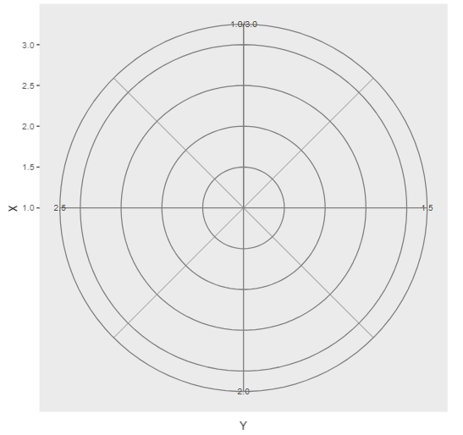
Coordinates - polar
+ coord_polar(“y”)
(x, y)
Notes:
Apply transformations to the x and y positions AFTER the data has been processed by the stat

Slide 45
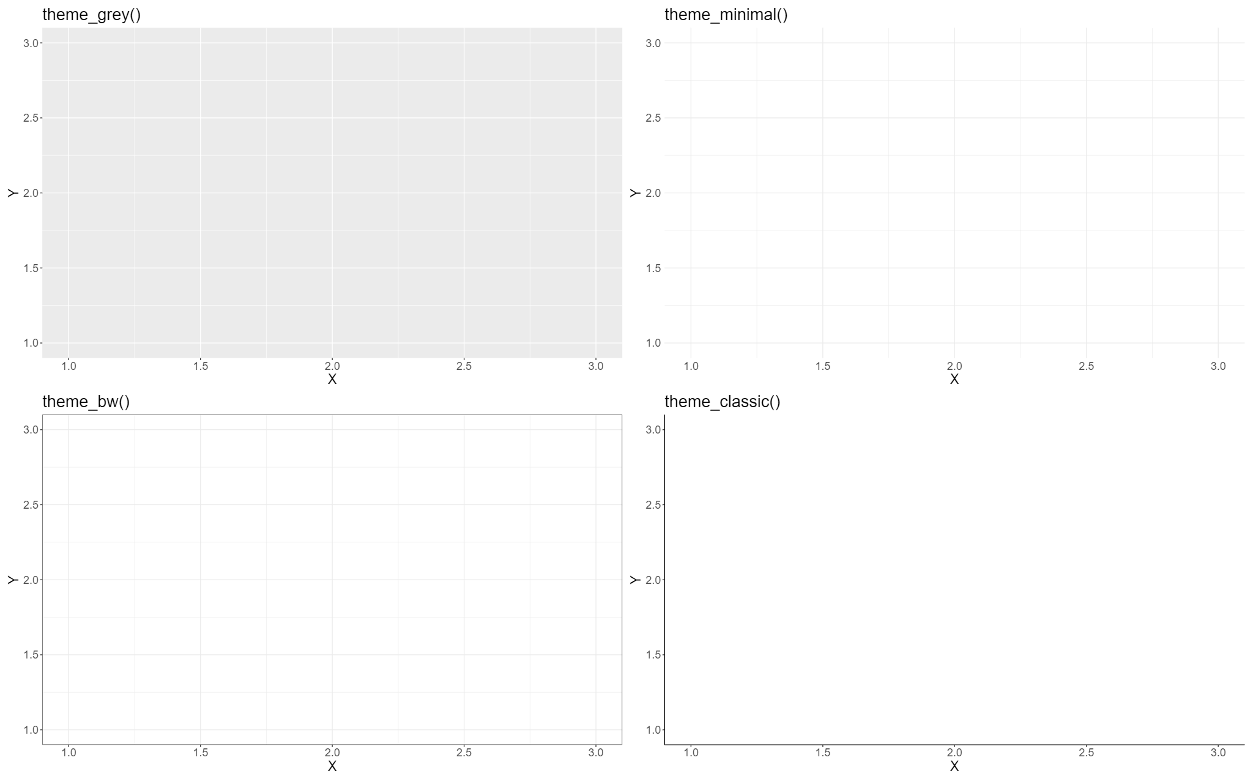
Themes – ggplot built-in
(x, y)

Slide 46
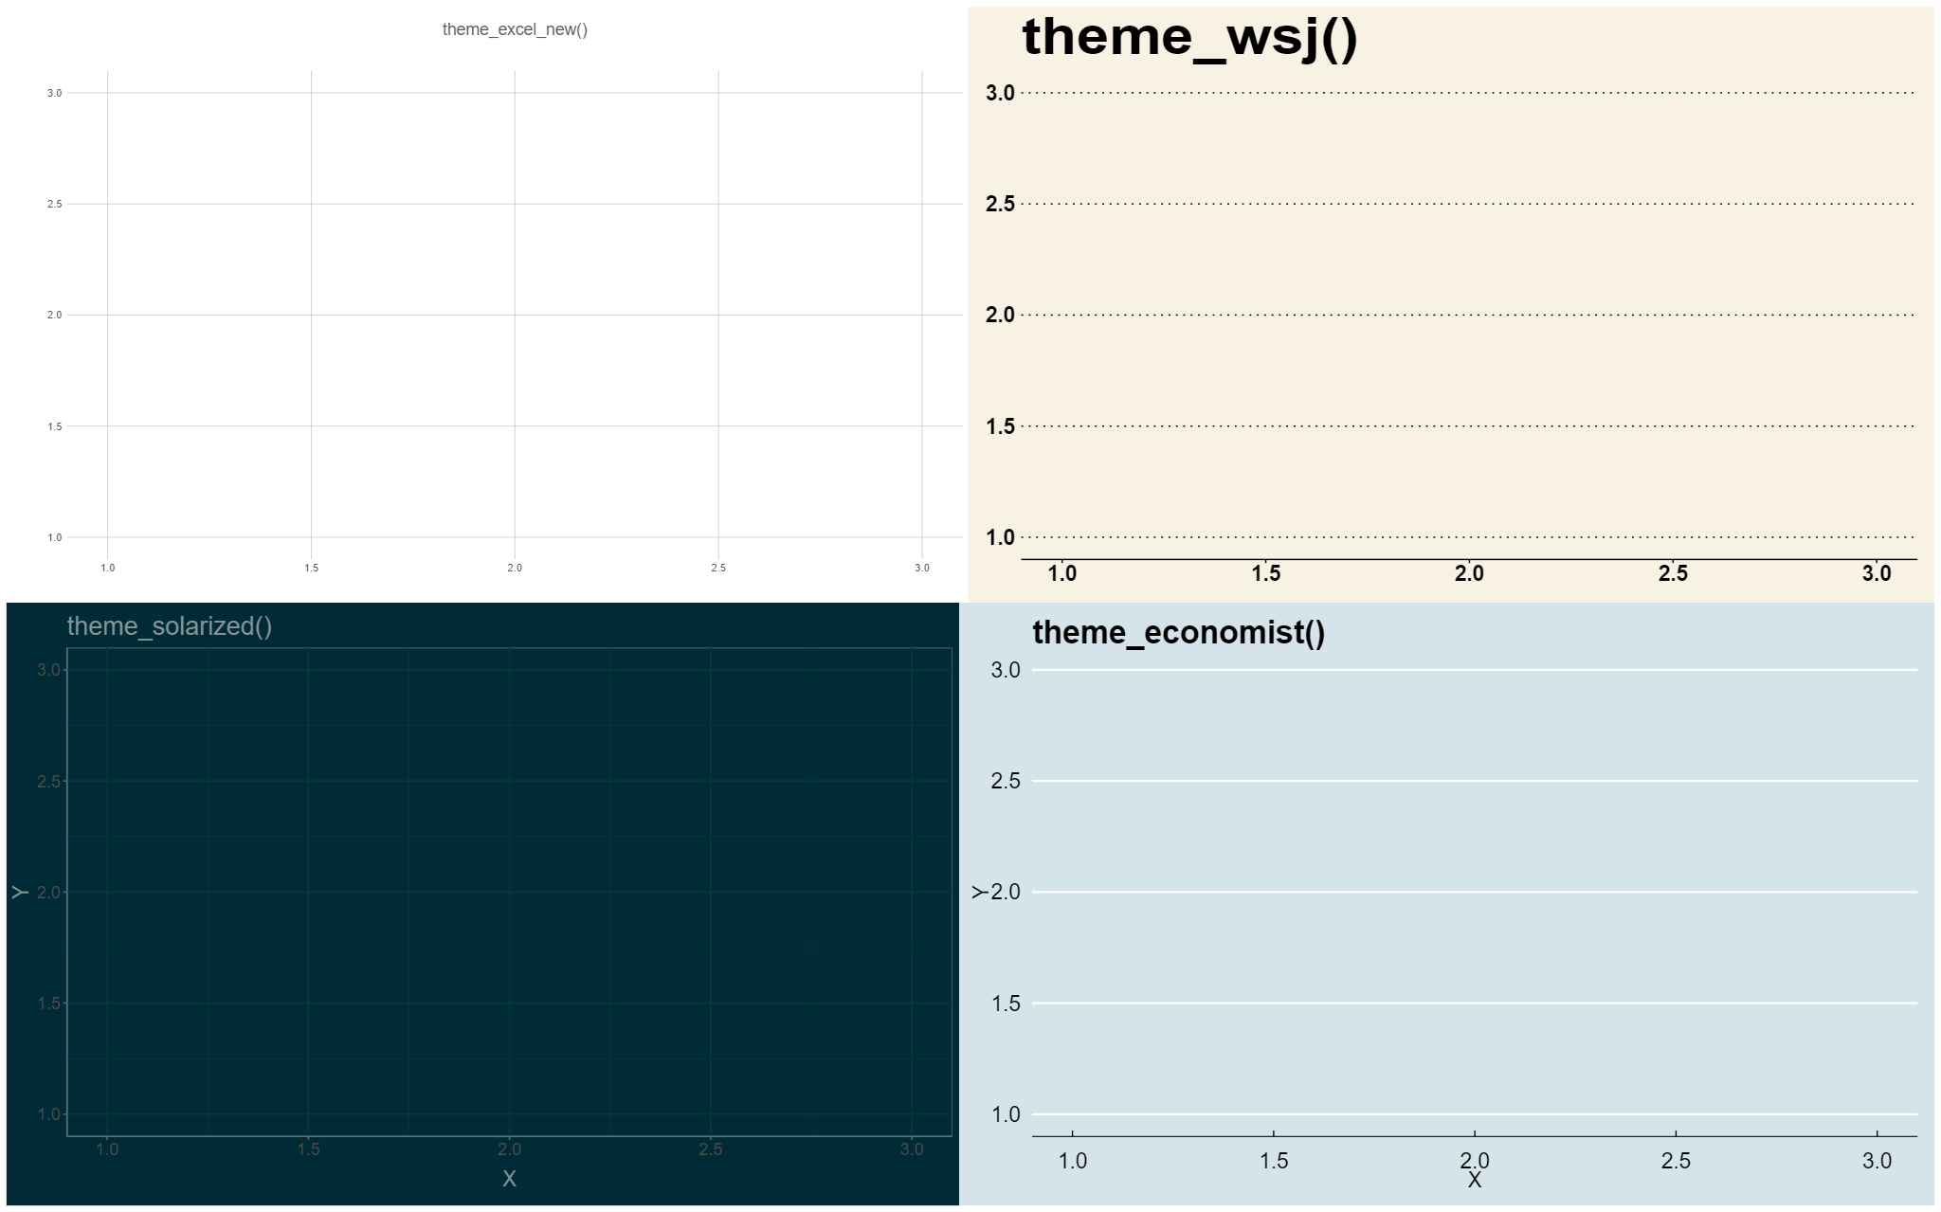
Themes -bespoke
(x, y)

Slide 47
Themes – customize elements
+ theme(
plot,
text,
panel,
axis,
legend,
gridlines
)

Slide 48
Hands on activity
Modify the `theme_AFS()` code to create a custom ggplot theme and apply to the black drum lengths by months plot

Slide 49
5 Minute Break

Slide 50
Group Project
Choose a dataset and create the plots as instructed, then improve them based on what you learned today

Slide 51

Taylor Swift Eras Tour Setlist Dataset
Goal: Create one or more plots to communicate what contributes to the popularity of songs within the setlist.
Data collected from Spotify’s Eras Tour Setlist Playlist
“./Day1/Project/TS_Eras_Exploration.csv”

Slide 52
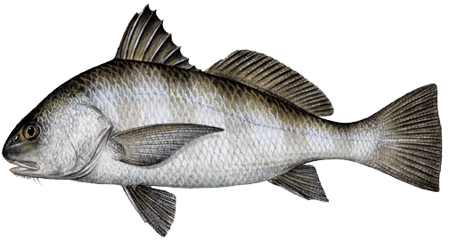
Black Drum Age and Lengths Dataset
Goal: Describe the demographics of the sampled Black Drum from Virginia in 2001
Biological data for Black Drum from Virginia waters of the Atlantic Ocean in 2001
“./Day1/Project/ BlackDrum2001_Exploration.qmd”

